Slide 1
Reservation Guideline
Hyatt Regency Tianjin East

Slide 2
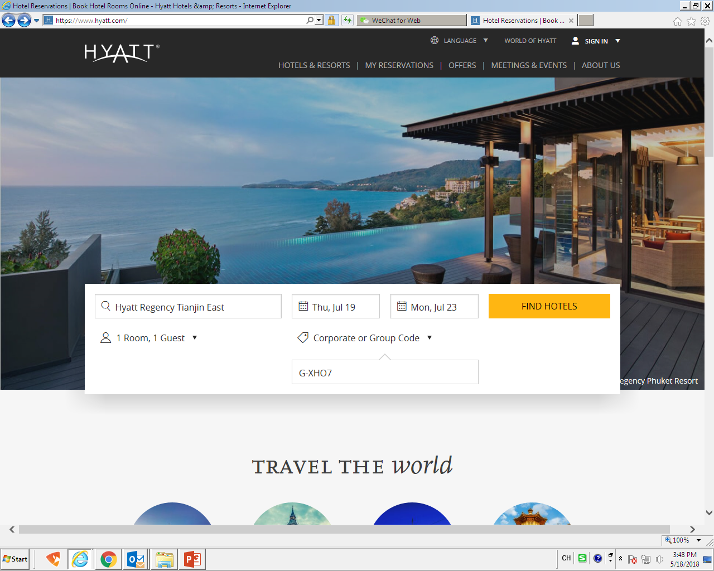
Log in https://www.hyatt.com/
Select Hotel “Hyatt Regency Tianjin East”- Choose Check in-Check out date-Select number of guest
Choose Corporate or Group code in “Special Rate”
Enter“G-XHO7”and click “ Find hotels”to next page
Enter hotel name
Number of guest

Slide 3
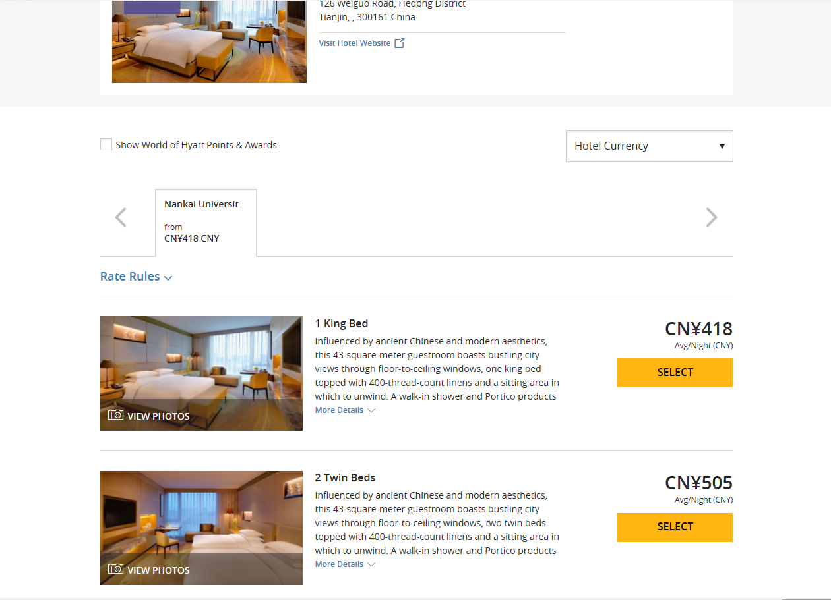
The special group rate for 2018 IEEE CYBER group will appear
Please select room type and click “Select ” to next page
点击
Enter

Slide 4
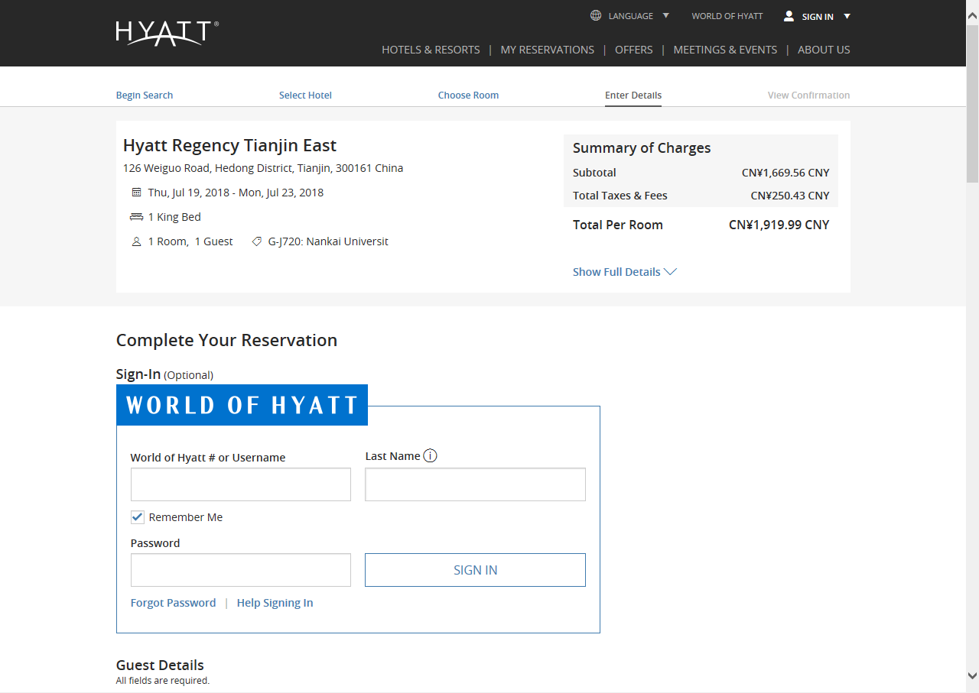
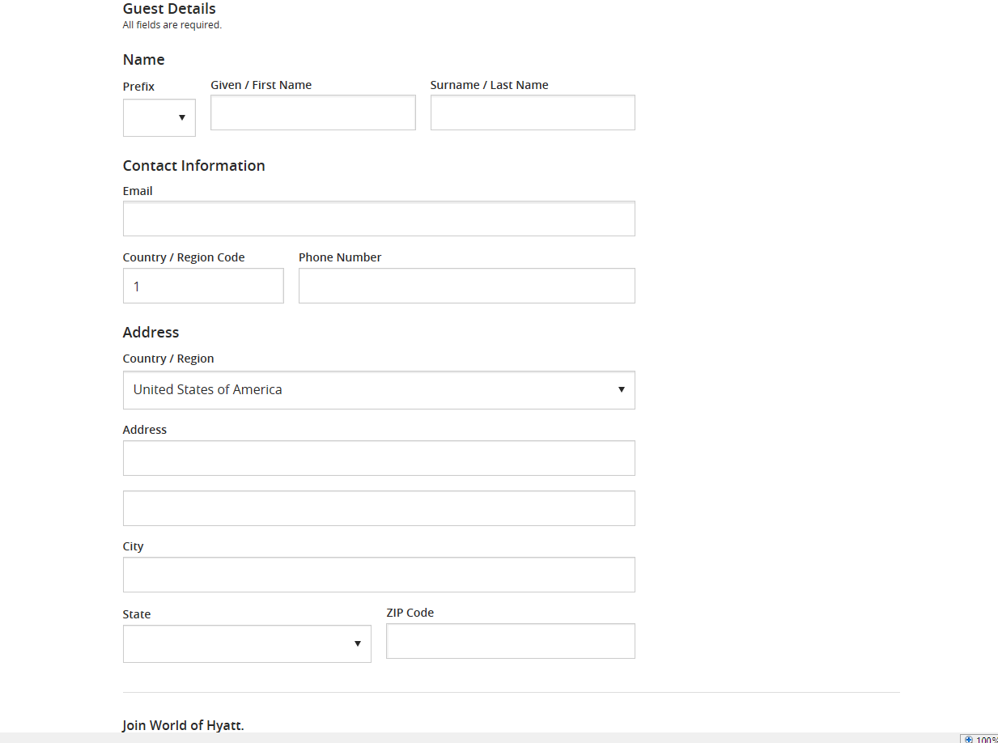
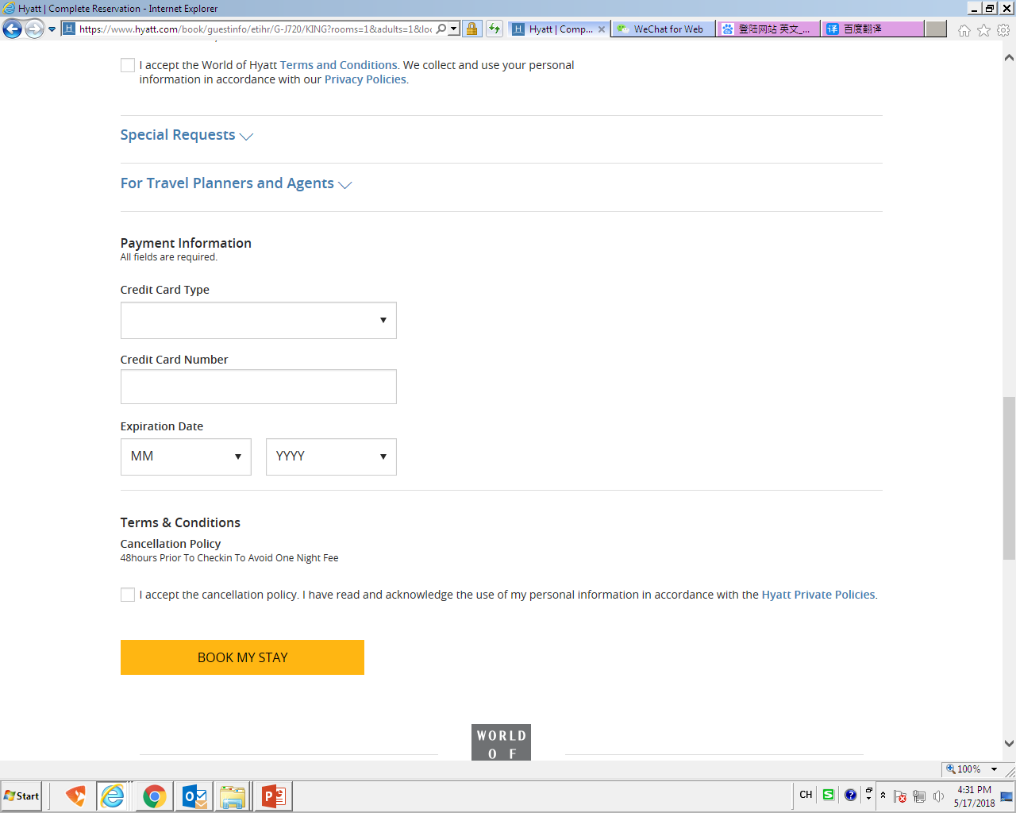
Fill in guest information & Credit card information as required
You will receive confirmation email instantly after your booking confirmed
Fill in Guest information
Credit card information

Slide 5
Attention：
Online booking room capacity maximum :
19July: 100 room nights
20July: 100 room nights
21July: 80 room nights
22July: 60 room nights
Hotel contact person： Laura Li
Tele：86 189 0203 0697
Email：laura.li@hyatt.com
Booking Deadline: 30June,2018
After deadline time, booking will be subject to availability

